Slide 1
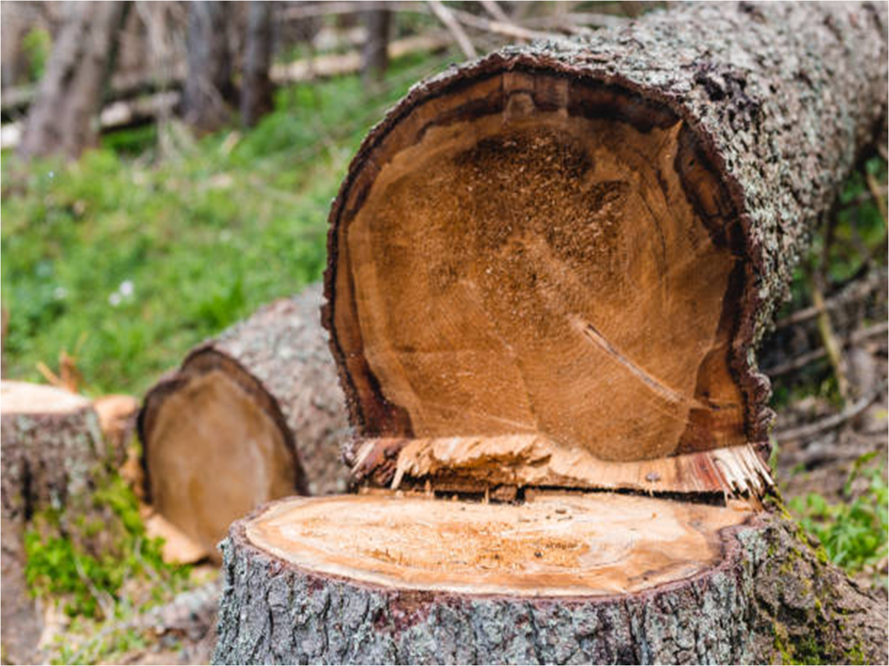



Department of Computer Science and Engineering
Project Phase – II (18CSP83)
Review – 1
PROTECTION OF FOREST TREES AGAINST POACHING BASED ON IOT
Group No.: 6 Batch No.: 2021_CSE_26
Guided By:
Mr. Roopesh Kumar
Assistant Prof, Dept of CSE, KSIT
1KS18CS115 Vijay N S
1KS18CS074 Pullur Pavan Kumar
1KS18CS087 Sandeep Kumar
1KS18CS063 Nitish Kumar

Slide 2


Introduction
Comparison with similar work
Problem Statement and Objectives
Methodology Proposed / Design
Technologies / Tools Used
Implementation of Modules with codes
Snapshots
References

Slide 3

INTRODUCTION
In recent years poaching or smuggling of environmentally and economically important species of trees in forested areas- such as Sandalwood, Teakwood, Pine and Rosewood has been tremendously increased.
There have been several initiatives undertaken by different stakeholders-- and in particular – by the Govt. of India, to mitigate these problems.
The main idea presented in this paper is to design a portable wireless sensor node which is a part of wireless sensor Network.
It will be mounted on trunk of each tree, capable of detecting theft as well as automatically initiate & send alarm signals if any to remote terminal through wireless media.

Slide 4
Comparison with similar work
S.No | Title | Author | Year and Publication | Methodology | Objectives
1 | Anti-Poaching of Trees in Forest-Based on IoT | S. Sanjay Kumar, V. Ravi, Ch. Rajendra Prasad and P. Ramchandar Rao | IJEAT 2018 | Paper suggests gyro sensor to detect the inclination of the tree which are being cut) | Design a framework or system which will be utilized to restrict the sneaking of sandalwood trees
2 | Preventive System for Forests | Prasad R. Khandar | IJCST 2018 | Paper suggests to use Flex Sensor, Micro Controller To detect the bending of tree | Every tree will be equipped with electronics unit consists of Micro Controller, Flex Sensor and ZigBee module. There will be one sub server unit for area

Slide 5
S.No | Title | Author | Year and Publication | Methodology | Objectives
3 | Forest protection using wireless sensor network and IoT | Gyanaranjan Patra | 2021 Articles in press | It uses a video monitoring with raspberry pi | Detection of the forest fire
4 | An IoT based fire alarming and authentication system for workhouse using Raspberry Pi 3 | Imteaj | 2017 ECCE | Raspberry Pi 3 id used to control multiple Arduino integrated with sensors like light intensity sensor, gas smoke sensor and camera | A system which detects fire and provides the location of the affected region
5 | IOT enabled forest fire detection and online monitoring system | Abhinav Kumar Sharma1 ,MdFaizRaza Ansari | 2019 IJPAM | It uses various sensors like lm 35 sensor to temperature, smoke and fire sensors With raspberry pi module | Detection of fire near tree and detect location to prevent accidents

Slide 6
Existing System
PROPOSED SYSTEM
To build a protection system using Bluetooth 4.0 and GSM to alert the concerned authorities in case of sandalwood robbery.
Version 4.0 of Bluetooth is called smart Bluetooth because it includes basic Bluetooth, low energy and high speed protocols.
We are proposed a Wireless Sensor Network with Wi-fi module, this project is to developing such a system which can be used to restrict this smuggling.
Version 1.0 of Node MCU is called ESP-12E module where E stands for "Enhanced“ with ESP8266 open source development kit.

Slide 7
Existing System
PROPOSED SYSTEM
This protection model consists of two parts; protection circuit which serves the function of slave node and mobile application which is installed in every master node and monitors all the slave nodes.
A low power MSP430 microcontroller along with RF modules is being used.
Our Proposed System consists of two units, protection circuit which serves the function of Wireless Sensor Networks which is installed in every tree and Blynk app is the monitoring node.
A low cost and low power Arduino microcontroller along with a Wi-Fi module (Node MCU) is being used.

Slide 8
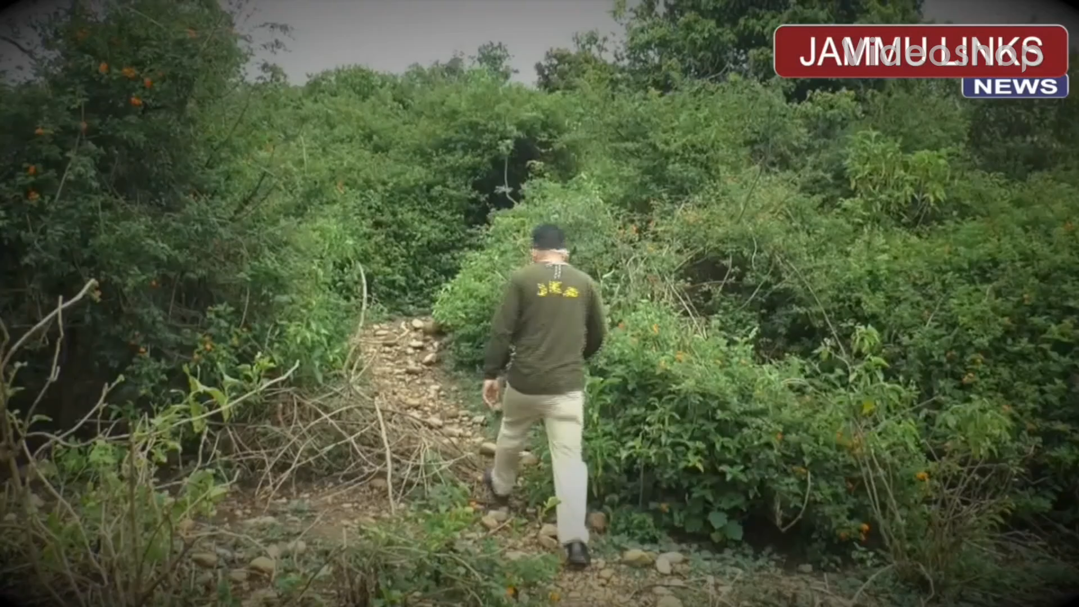

Slide 9

PROBLEM STATEMENT
“To design an IOT based Anti-Poaching Detection System which will detect smugglers cutting down trees and even forest fires using the help of sensors and also sends GPS location of the tree to the forest department using Blynk application.”

Slide 10

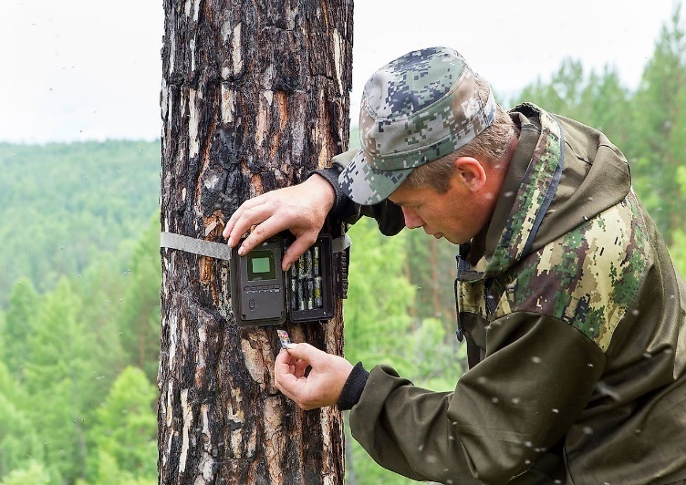
OBJECTIVES
The main objective of this project is to developing such a system which can be used to restrict this smuggling.
The main idea presented in this project is to
design a portable wireless sensor node
which is a part of wireless sensor Network.
It will be mounted on trunk of each tree,
capable of detecting theft as well as automatically initiate & send alarm signals if any to remote terminal through wireless media.

Slide 11
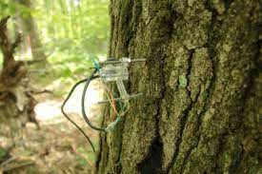
In this system a novel method has been introduced to prevent the cut down of trees using wsn and blynk
Tilt sensor is used to determine whether the tree is cut down or not similarly
Fire sensor is used to determine whether the forest is on fire or not.
This values will be constantly sent
to cloud through wifi which can
accessed using blynk application

Slide 12
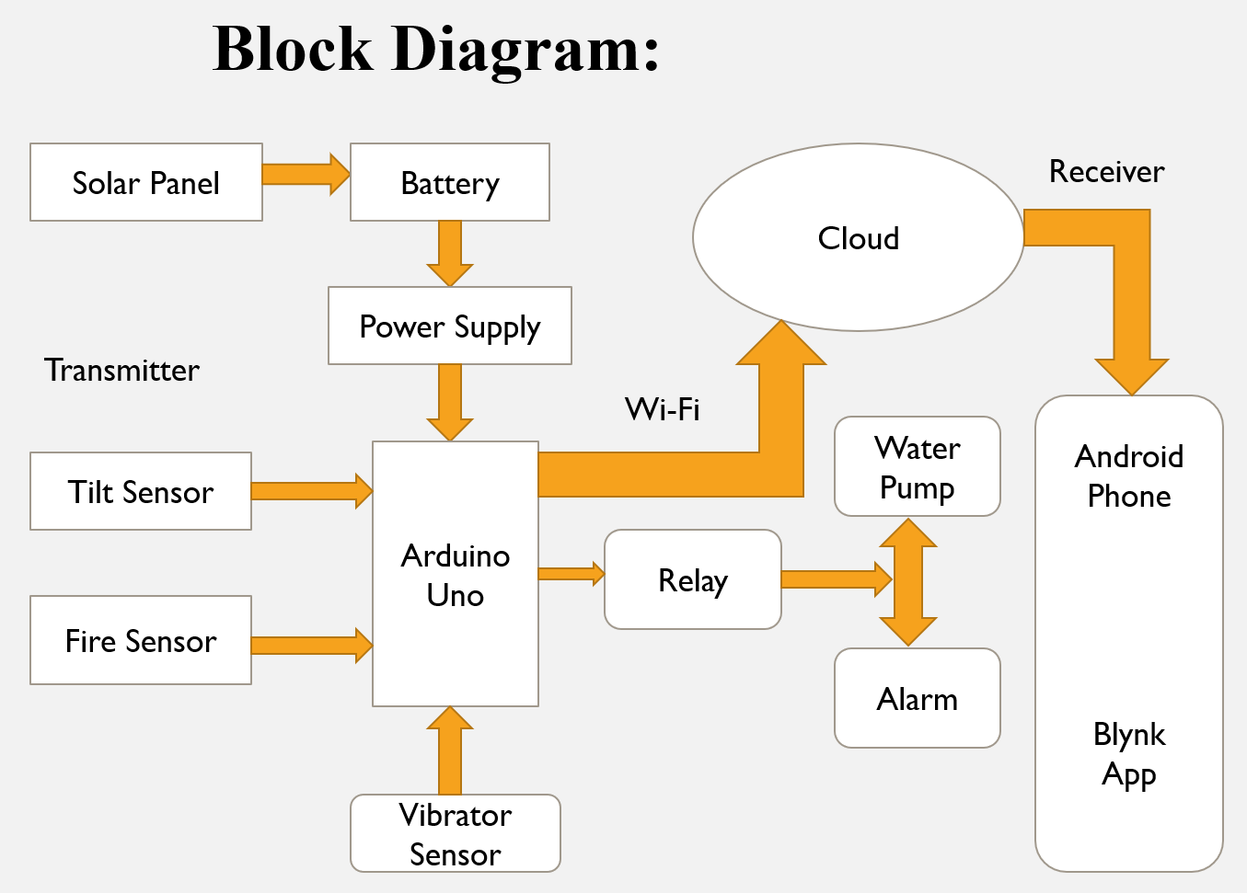
METHODOLOGY

Slide 13

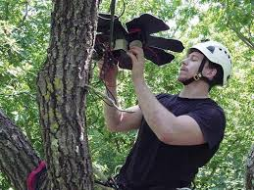
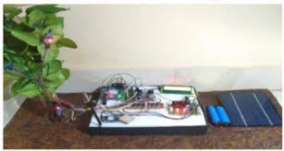
In this system we have given an idea to detect the fire in the forest by using modern equipments. The system is proposed to detect the fire in the forest and also to alert the forest officer about the fire in the forest.
Here a microcontroller is used to control the system activities, some sensors are used to detect the fire in the forest, with detecting the fire the exact location of the fire is detected and located to the nearby forest officer.
The solar panel with a battery is used to supply the source to the system. Since the system is designed to implement in the forest it not possible to provide power supply through transmission line hence a solar panel is used which can be charged and stored in a battery. It is given as source to the system.

Slide 14
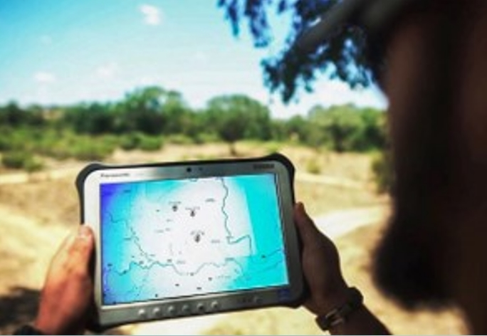

So the system is a complete IoT based system were the activities of the system is continuously monitored and the monitoring details are stored in online pages which is viewed by the officer regularly.
The details are stored as a data and this data can be viewed at any time.
The tilt sensor is used to know smuggling or cutting of the tree , the buzzer is used as a alarm to notify.
The GPS is find the exact location if any forest fire or smuggling or cutting of the tree is happen in the forest.

Slide 15

TECHNOLOGIES / TOOLS USED
IoT Technology with Wireless Sensor Network
The Internet of Things (IoT) describes the network of physical objects—“things”—that are embedded with sensors, software, and other technologies for the purpose of connecting and exchanging data with other devices and systems over the internet.
Tools used are:
Arduino IDE
Blynk Application

Slide 16
TECHNOLOGIES / TOOLS USED
HARDWARE REQUIREMENT:
• Arduino UNO
• Wi-Fi Module (Node MCU)
• Relay
• Water Pump
• Buzzer
• Tilt Sensor
• GPS module
• Fire Sensor
SOFTWARE REQUIREMENT:
• Arduino IDE
• Blynk Application

Slide 17

IMPLEMENTATION OF MODULES WITH CODE
We are having Two modules in our Project
In first module we are connecting a wireless sensors i.e., the Tilt sensor to detect a tree falling and Fire sensor to detect a forest fire if anyone of this is activated we will get the notification in the Blynk Application and Buzzer also turn on at a time we can turn on the water pump if fire is detected through the mobile phone.
In the second module we will get the exact location of the place where smuggling of tree or falling of tree had happen and also the location of forest fire place through the Blynk Mobile application.

Slide 18

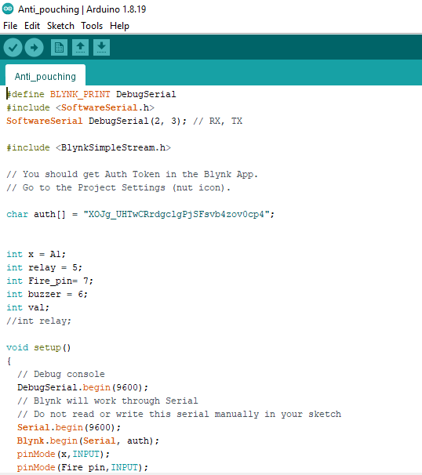
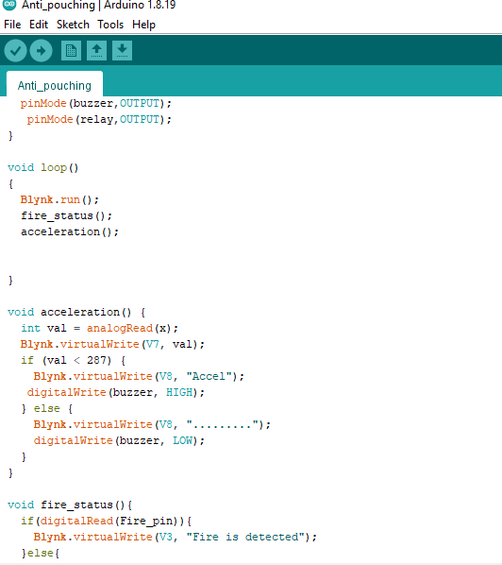
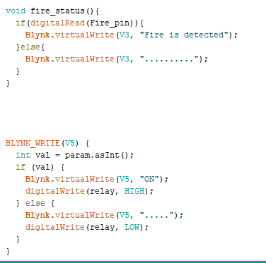
MODULE 1 SNAPSHOTS

Slide 19
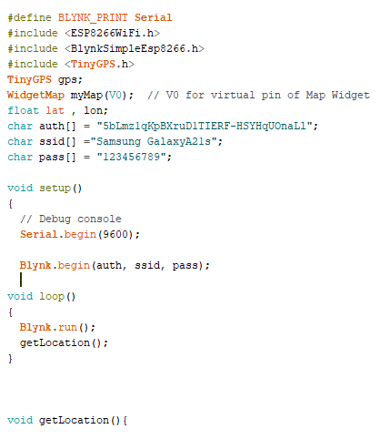
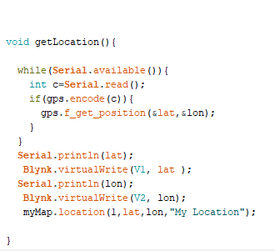
MODULE 2 SNAPSHOTS

Slide 20

REFERENCES
[1] Journal /Article /Paper Hameem C Hamza Tree Theft Control System 2013 Texas Instruments India Educators Conference.
[2] Ghousia Sultana B IOT Based Anti-Poaching Alarm System for Trees in Forest using Wireless Sensor Network Volume 9, Special Issue No. 3, May 2018.
[3] Subhashini A Smuggling preventions system for trees in forest using IOT Chennai International journal of scientific research and innovations IX (2018) 15-22.
[4] Mr V. Narasimman Asst.Prof Design of a WSN node for forest trees against poaching.
[5] B S Sudha Yogitha Forest monitoring system using Wireless Sensor Network Volume 4, Issue 4 April2018.

Slide 21
[6] M. Lee, J.wang and H. Yoe, "Agricultural Production System Based on IoT," 2013 IEEE 16th International Conference on Computational Science and Engineering, Sydney, NSW, 2013, pp. 833-837.
[7] J. Grand C. Molina-Colcha, S. Hidalgo-Lupera and C. Valarezo "Design and Implementation of a Wireless Sensor Network for Precision Agriculture Operating in API Mode," 2018 International Conference on eDemocracy & eGovernment(ICEDEG), Ambato, 2018, pp. 144-149.
[8] S. Gio, I. Seitanidis, M. Ojo, D. Adam and F. Ving, "IoT solutions for crop protection against wild animal attacks," 2018.
[9]Anti-Poaching of Trees in Forest-Based on IoT IOP Publishing 2020 by
S.Sanjay Kumar1 , V.Ravi2 , Ch.Rajendra Prasad3 , P.Ramchandar Rao4
[10] An Autonomous IoT Infrastructure for Forest Fire Detection and Alerting System from International Journal of Pure and Applied Mathematics R. Niranjana , Dr.T.HemaLatha, Associate Professor

Slide 22

THANK YOU

